Slide 1
APUSH Review: The Frontier
Everything You Need To Know About The Frontier To Succeed In APUSH

Slide 2
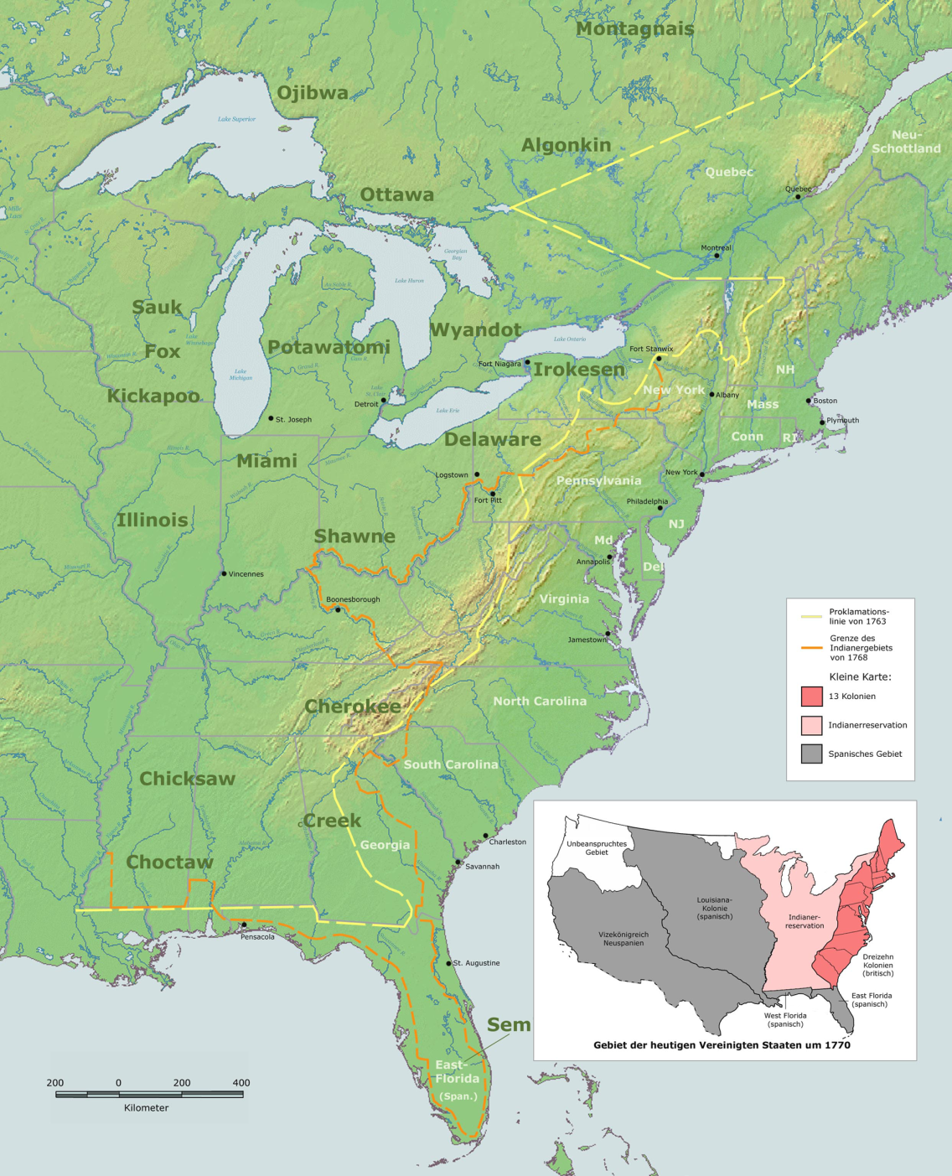
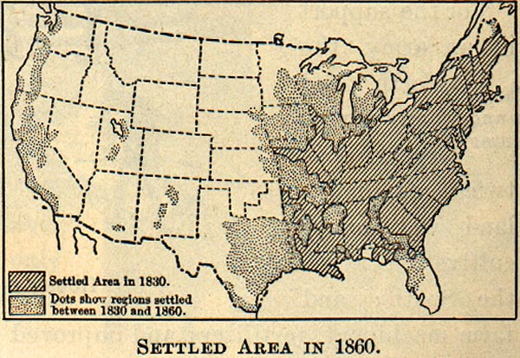
The Frontier: An Intro
What was it?
A line that separated east and west (civilization from wilderness)
Throughout American history, the line shifted further and further west
Why is it so important?
Many Americans viewed it as an opportunity
“Safety-Valve” Theory
Idea that people could always move to the Frontier in times of economic crises
In reality, many did not take advantage of the Frontier, but it represented optimism

Slide 3
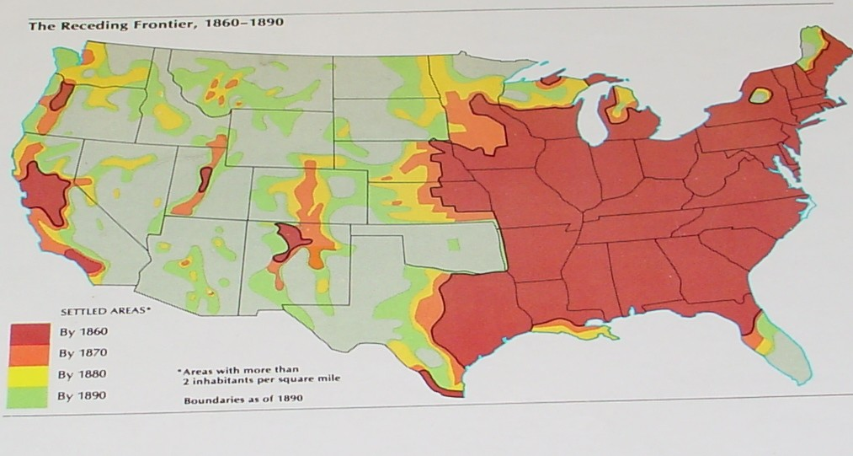
1890: The Census
For the first time in US History, a frontier line no longer was visible
What contributed to the decline of the Frontier?
Mass migration out west
Gold rushes
Homestead Act of 1862

Slide 4

1893: An Important Thesis
"Up to our own day American history has been in a large degree the history of the colonization of the Great West. The existence of an area of free land, its continuous recession, and the advance of American settlement westward, explain American development."
Significance of the Frontier in American History
Written by Frederick Jackson Turner
The Main Idea of the writing:
The end of the Frontier ended a unique era in US history
The Frontier contributed to the American identity
Helped make American society different from Europe

Slide 5
Impact of the End of the Frontier
Many historians argue that the closing of the Frontier helped lead to overseas expansion
Asia
Caribbean
Native Americans lost much of their land
The Frontier in 1890 =
Sorry bro, we’re closed

Slide 6
Thanks for watching!
Subscribe to my channel
Help spread the word
Questions? Comments? Ideas for videos?
Leave in comments
Subscribe
Up here!

